Slide 1
Cricket world cup 2023 analysis
BY: VAIBHAV SINGH
BATCH: MIP-ML-08

Slide 2
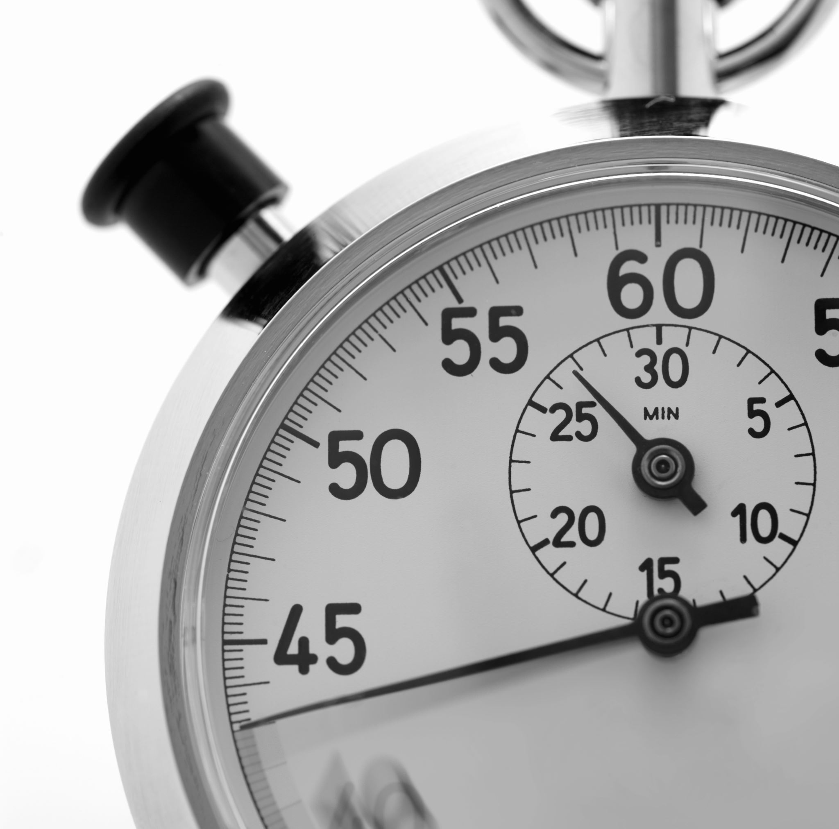
AGENDA
Project Overview
Dataset Overview
EDA
Data Preprocessing
Solution to given tasks

Slide 3
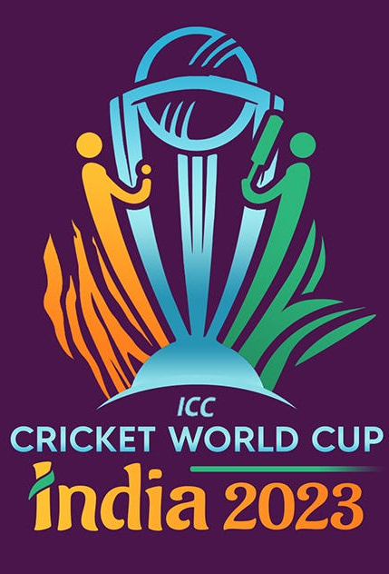
PROJECT OVERVIEW
The Cricket World Cup 2023 data analysis aims to delve into the cricketing world, specifically focusing on the performance of teams and players during the prestigious tournament. The dataset provided encapsulats a comprehensive array of features, offering an opportunity for us to conduct a thorough exploratory data analysis and extract valuable insights.

Slide 4
Dataset overview
The dataset comprises of the following columns:
team
player
bat_or_bowl
bb_bf (balls bowled or balls faced)
runs
wkts (wickets)
wicketball_prob
runs_per_ball
opposition
ground

Slide 5
Dataset overview
The dataset comprises of the following columns:
start_date
overs
mdns (maidens)
econ (economy rate)
inns (innings)
4s (fours)
6s (sixes)
sr (strike rate)l
not out
mins (minutes)

Slide 6
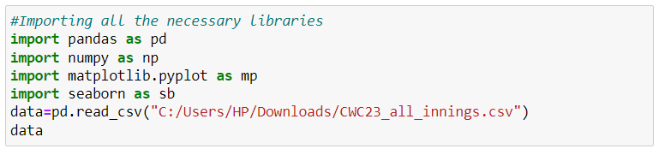
Importing essential libraries
Essential libraries are imported
Dataset is read from the stored location.
VAIBHAV SINGH
6

Slide 7
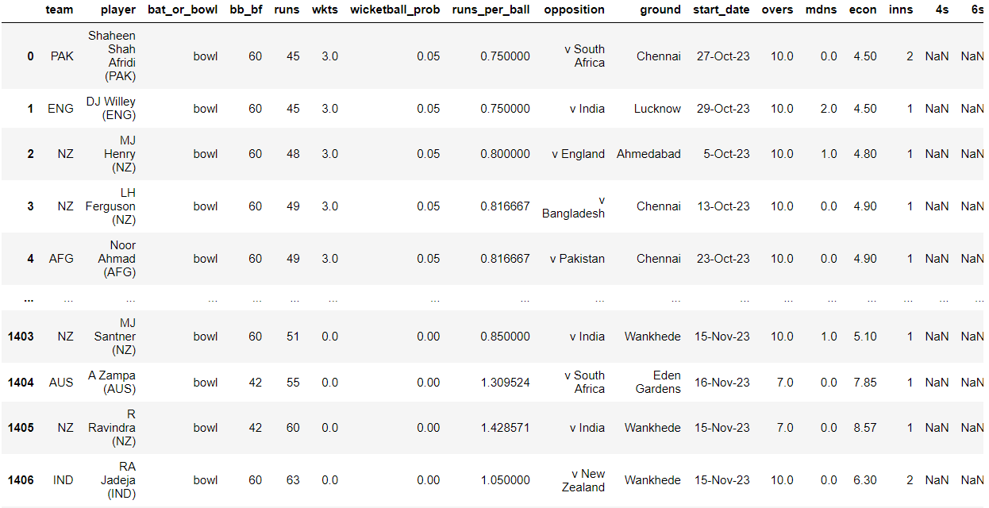
Provided dataset
The dataset provided has 1408 rows and 20 attributes.
Few of the Attributes are:
team
player
4s
wkts

Slide 8
EDA
In EDA, we'll observe the information and statistical.

Slide 9
Dataset description
We can observe the statistical measures like mean, standard deviation, maximum and minimum values along with various quartile ranges for our dataset.

Slide 10
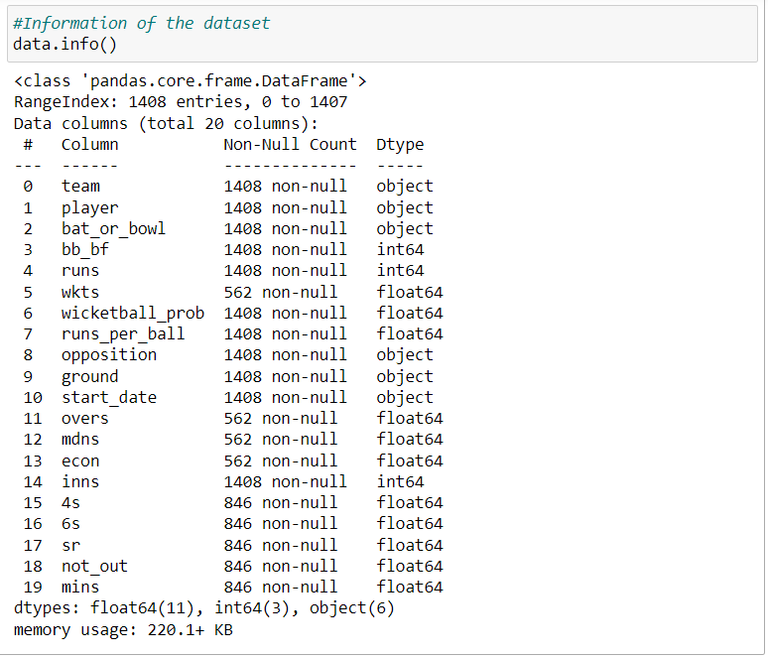
Dataset information
We can observe the information of the dataset like RangeIndex, Number of columns, data types, non-null count and the number of records of each attribute.

Slide 11
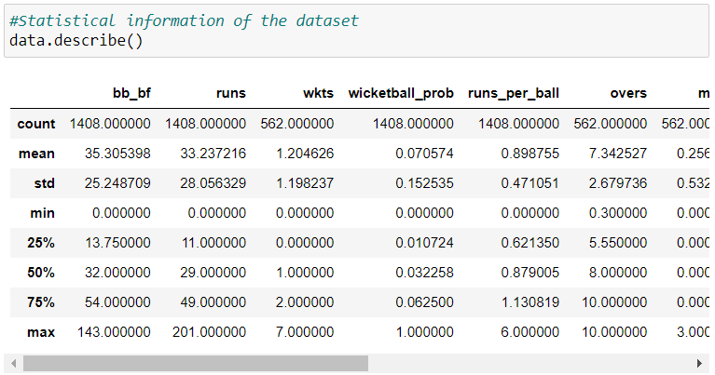
Dataset description
We can observe the statistical measures like mean, standard deviation, maximum and minimum values along with various quartile ranges for our dataset.

Slide 12
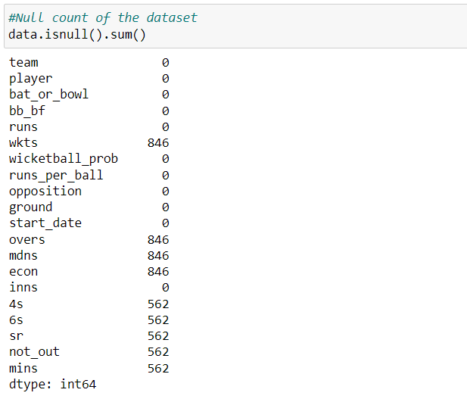
Null count of each attributes
Here we see the null count of:
'wkts': 846
'overs': 846
'mdns': 846
'econ': 846
'4s': 562
'6s': 562
'sr': 562
'not_out': 562
'mins': 562
All other attributes have zero null values

Slide 13
Data preprocessing
We'll transform the raw data into an understandable form for suitable analysis.

Slide 14

Data cleaning
We're cleaning the value of the attribute-opposition.
Here we're replacing the 'v' string from the record with ' ' value for better visualization and analysis.

Slide 15
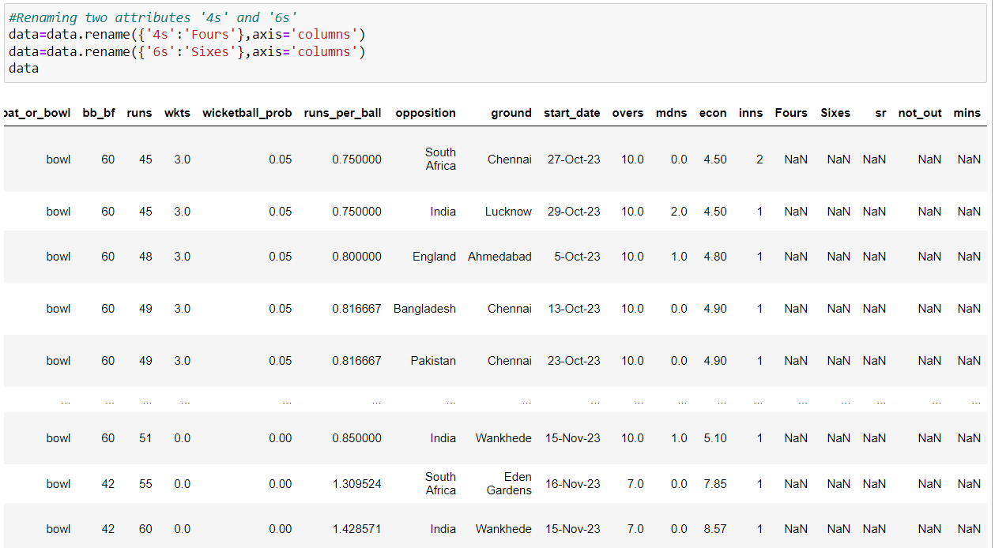
Data cleaning
Renaming the two attributes '4s' and '6s' with 'Fours' and 'Sixes' respectively.

Slide 16
Team performance analysis
This is our first task to perform, where we'll explore team-wise performance metrices, analyze runs scored, wickets taken and identify the top-performing teams.

Slide 17
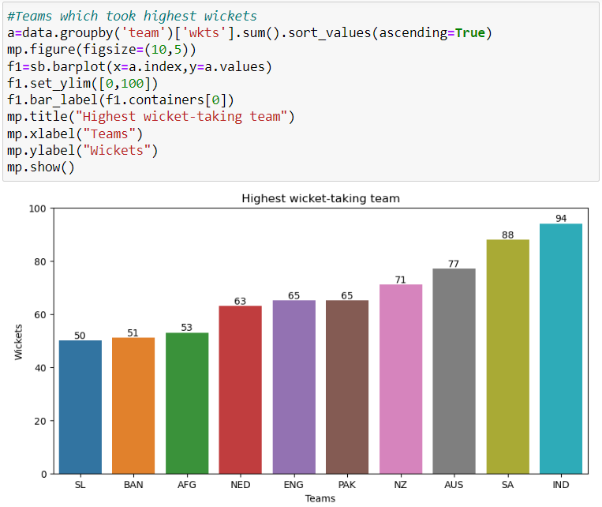
Team which took highest wickets
Using the barplot, we observe that the highest wicket-taking team is India with 94 wickets.

Slide 18
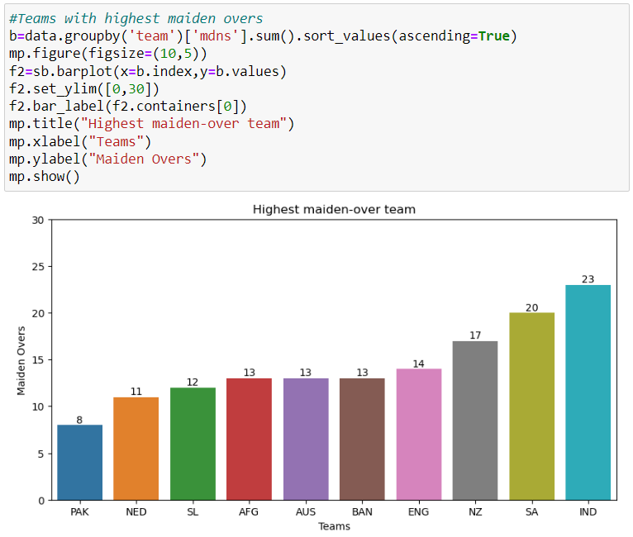
Team with highest maidens
Using the barplot, we observe that the team with highest maiden is India with 23 maiden overs.

Slide 19
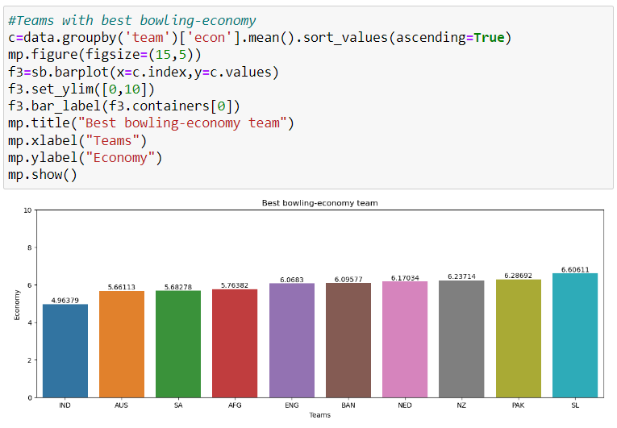
Team with best bowling economy
Using the barplot, we observe that the team with best bowling economy average with 4.96 is India.

Slide 20
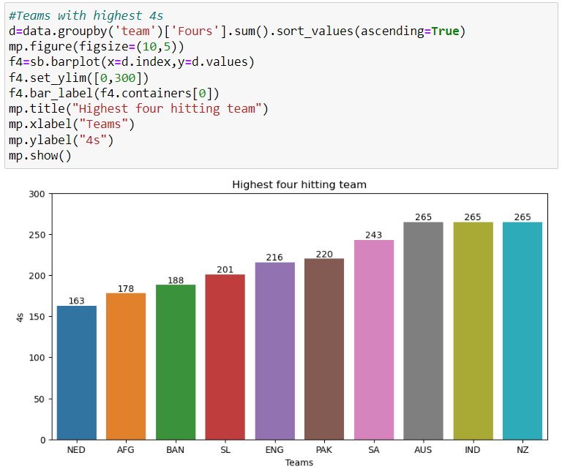
Team with most 4s
Using the barplot, we observe that the team with most 4s is Australia, India and New Zealand with 265 fours.

Slide 21
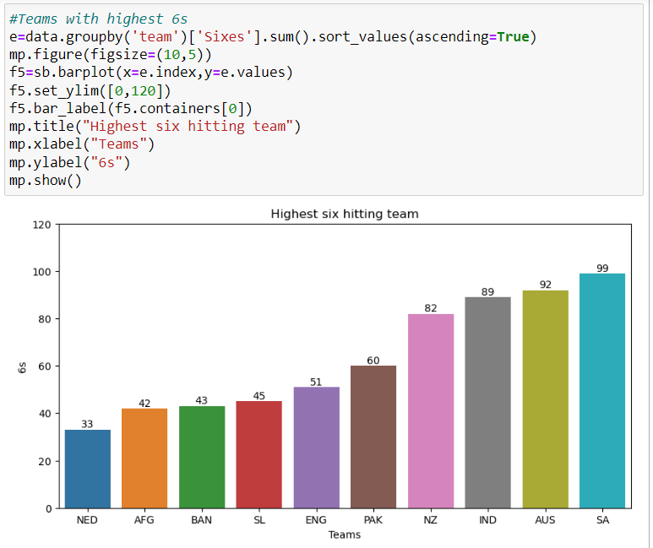
Team with most 6s
Using the barplot, we observe that the team with most 6s is South Africa with 99 sixes.

Slide 22
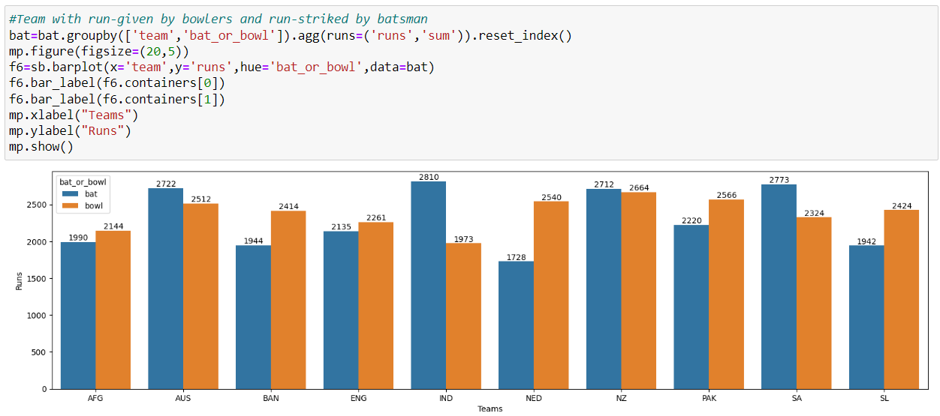
Team with maximum run-given and run-scored
Using the barplot, we observe that the team with best performance in batting and bowling both is team India.

Slide 23
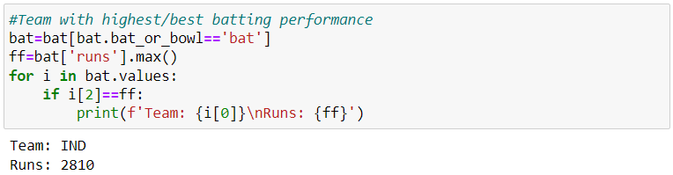
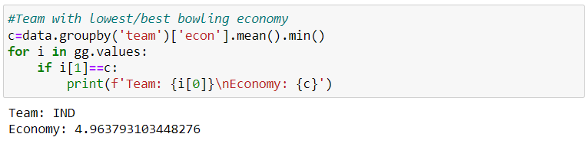
Team with top performance
We can observe that the team with top performance is team India in both batting and bowling.

Slide 24
Player performance analysis
This is our second task to perform, where we'll explore player-wise statistics for both bowling & batting, identify leading run-scorers and wicket-takers, along with their impact on team's performance .

Slide 25
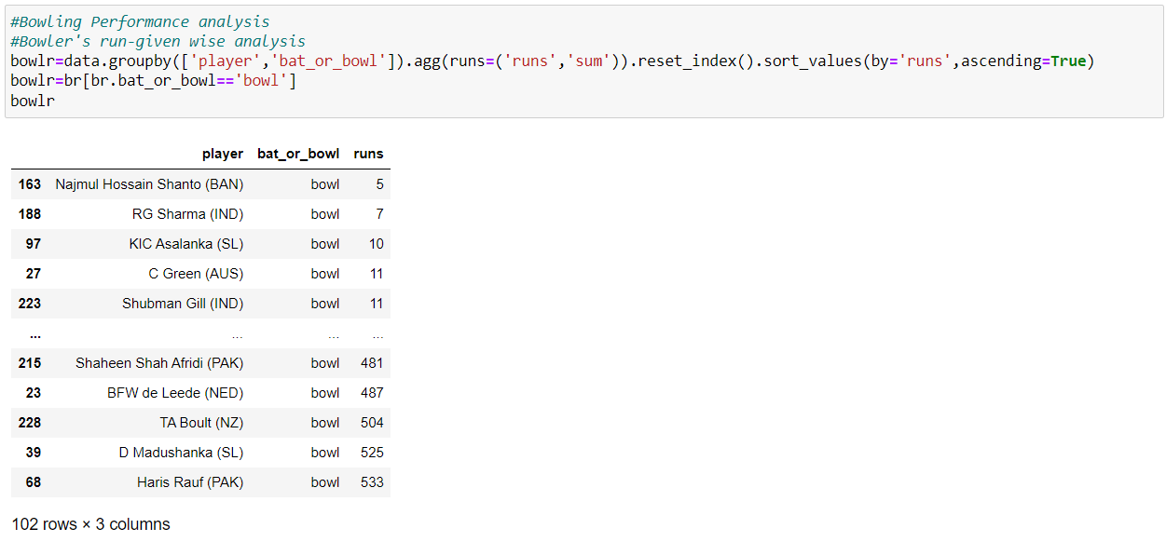
Bowler's run-given wise analysis
We're using groupby function to group out the bowlers with the sum of the runs-given by them in ascending order.

Slide 26
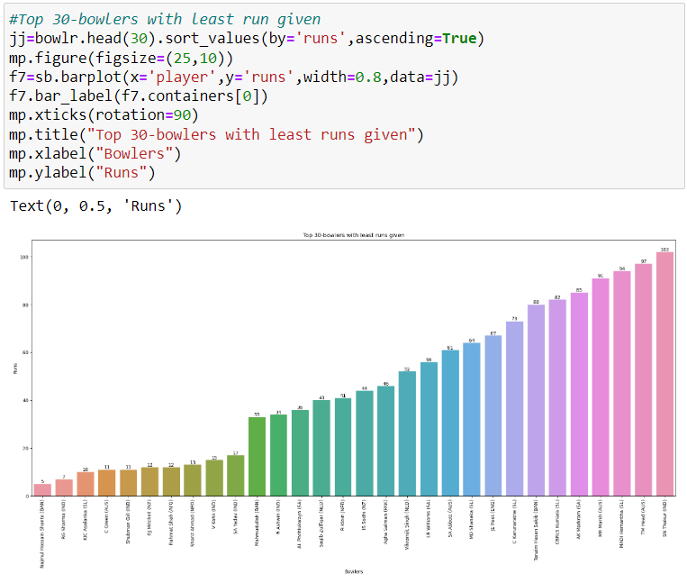
Player with least runs-given
Using the barplot, we observe that top 30 players with least runs-given throughout the tournament and Najmul H. Shanto (BAN) is the topper.

Slide 27
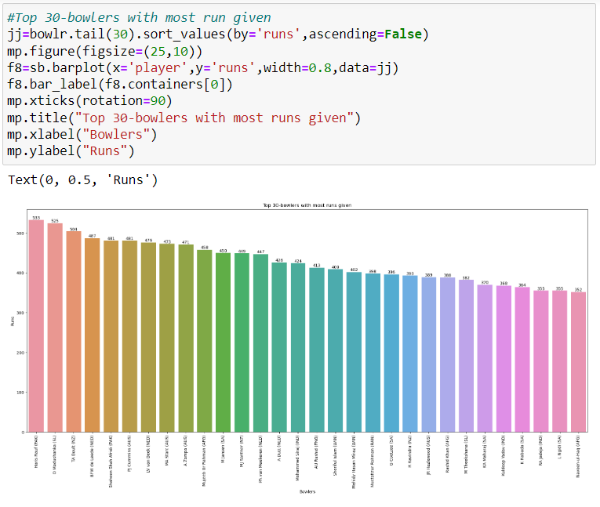
Player with most runs-given
Using the barplot, we observe that top 30 players with most runs-given throughout the tournament and Hasif Rauf (PAK) is the topper.

Slide 28
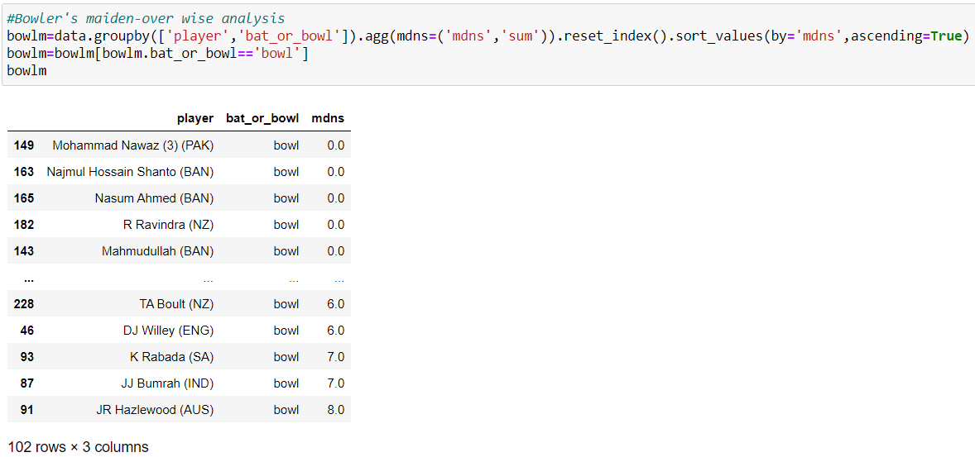
Bowler's maiden-over wise analysis
We're using groupby function to group out the bowlers with the sum of the maiden overs given by them in ascending order.

Slide 29
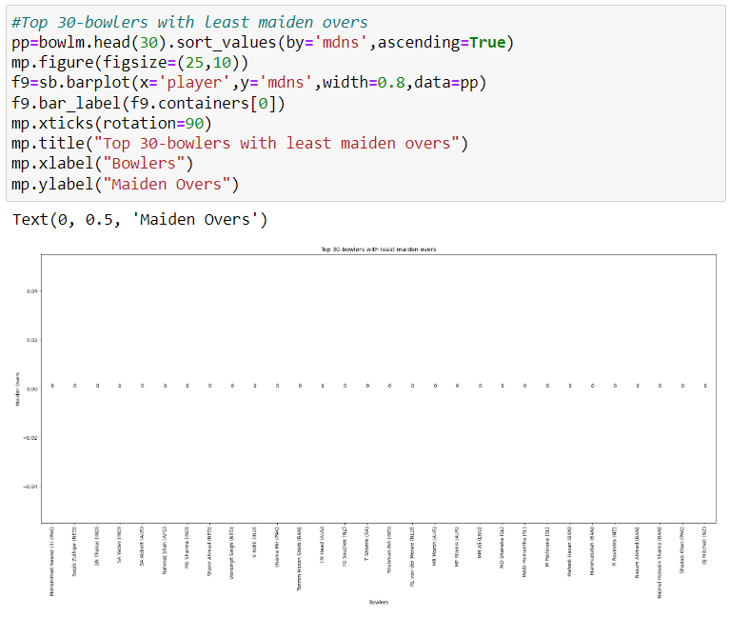
Player with least maiden-overs
Using the barplot, we observe that top 30 players with least maiden-overs throughout the tournament.

Slide 30
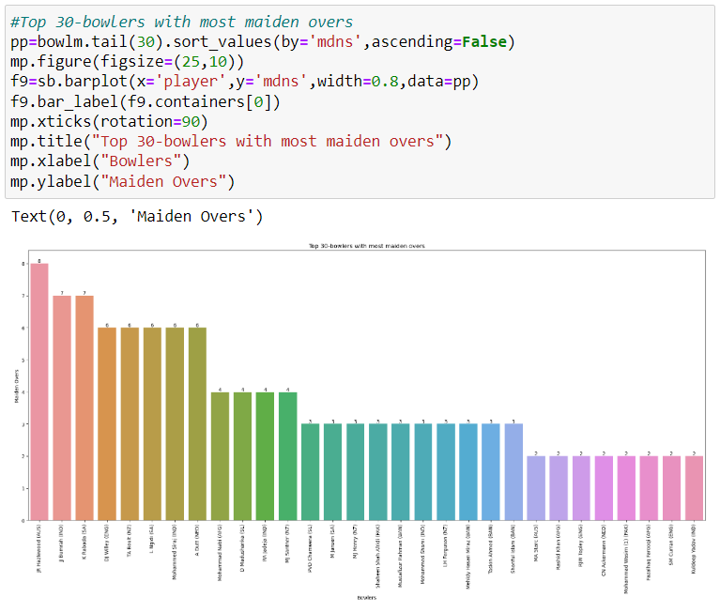
Player with most maiden-overs
Using the barplot, we observe that top 30 players with most maiden-overs throughout the tournament and JR Hazlewood is the topper with 8 maiden overs.

Slide 31
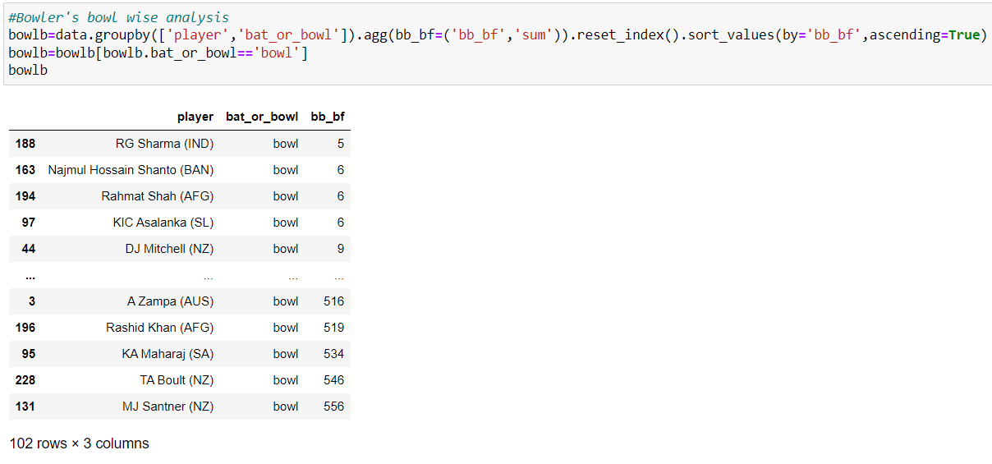
Bowler's bowling-count wise analysis
We're using groupby function to group out the bowlers with the sum of the bowling-count in ascending order.

Slide 32
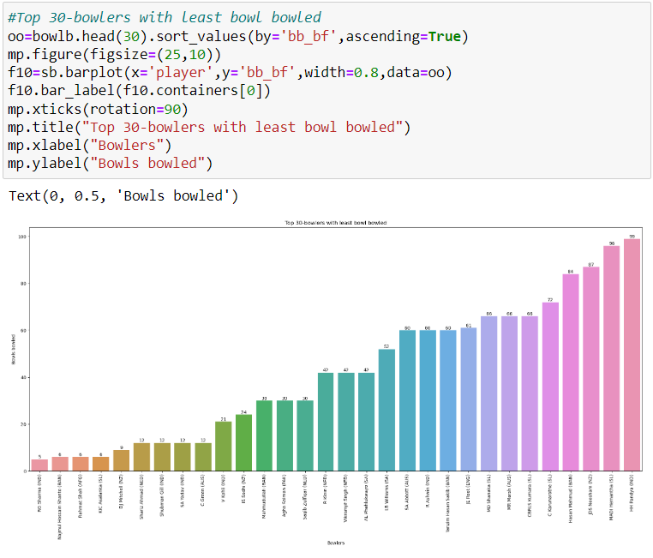
Player with least bowling-count
Using the barplot, we observe that top 30 players with least bowling-count throughout the tournament and RG Sharma (IND) is the topper with 5 bowls.

Slide 33
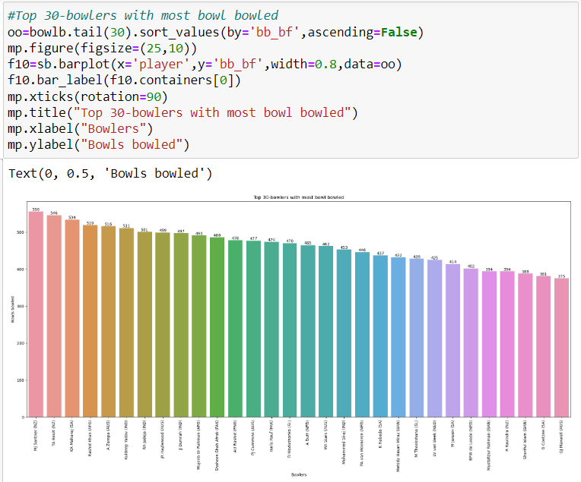
Player with most bowling-count
Using the barplot, we observe that top 30 players with most bowling-count throughout the tournament and MJ Shatner (NZ) is the topper with 556 bowls.

Slide 34
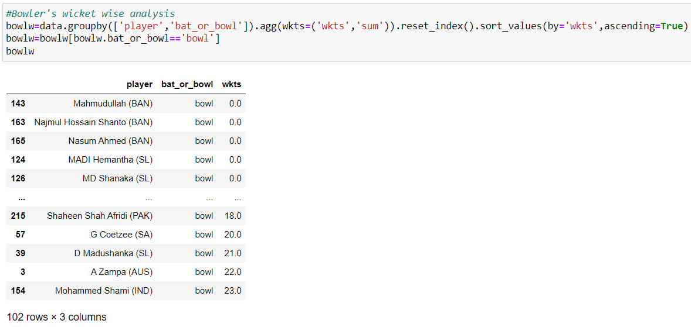
Bowler's wickets-taken wise analysis
We're using groupby function to group out the bowlers with the sum of wickets-taken in ascending order.

Slide 35
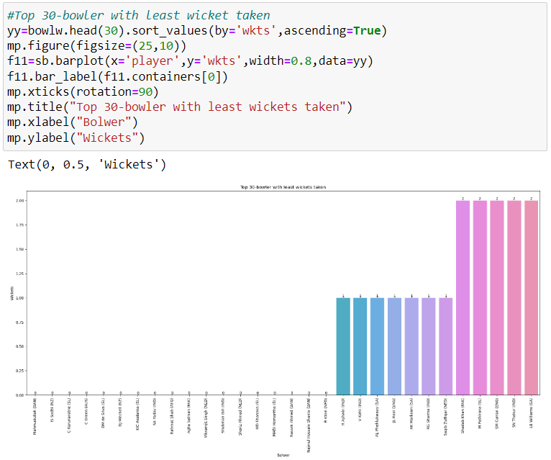
Player with least wicket-taken
Using the barplot, we observe that top 30 players with least wicket-taken throughout the tournament are 8 players with 0 wickets.

Slide 36
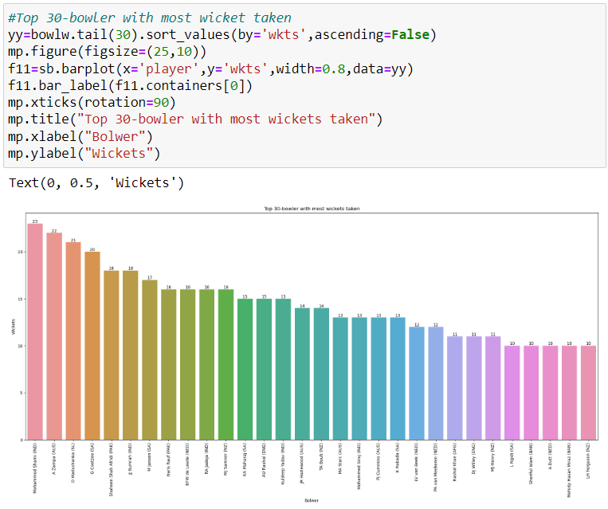
Player with most wicket-taken
Using the barplot, we observe that top 30 players with most wicket-taken throughout the tournament and Mohammed Shami (IND) is the topper with 23 wickets.

Slide 37
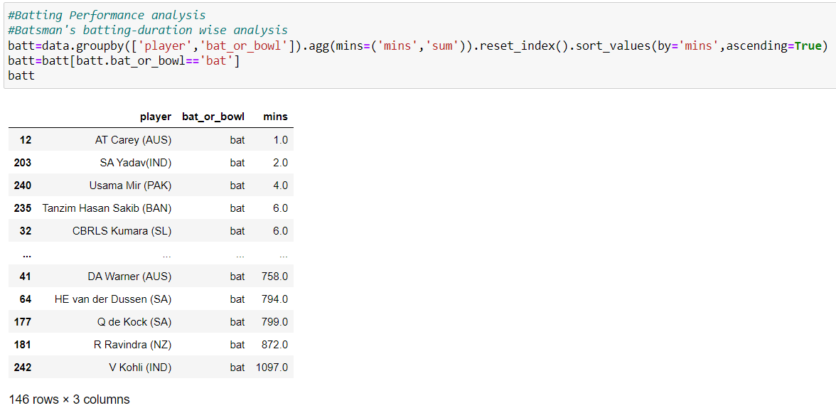
Batsman's batting duration wise analysis
We're using groupby function to group out the batsmen with the sum of their batting duration in ascending order.

Slide 38
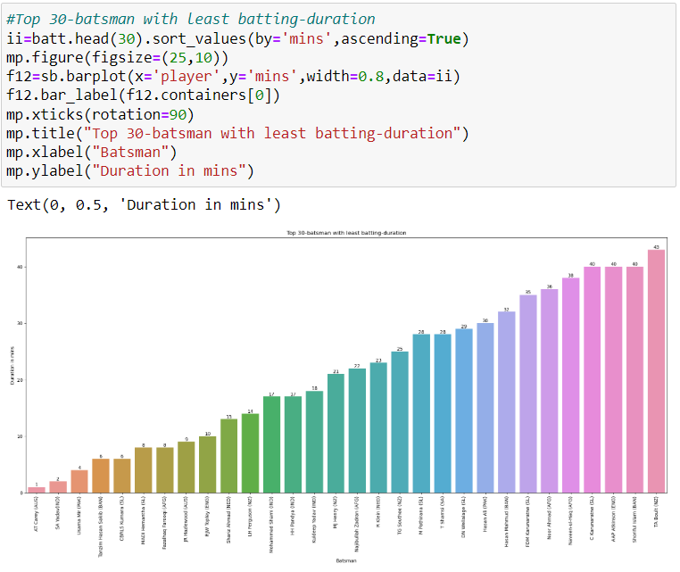
Player with least batting duration
Using the barplot, we observe that top 30 players with least batting duration throughout the tournament and AT Carry (AUS) is the topper with 1 min.

Slide 39
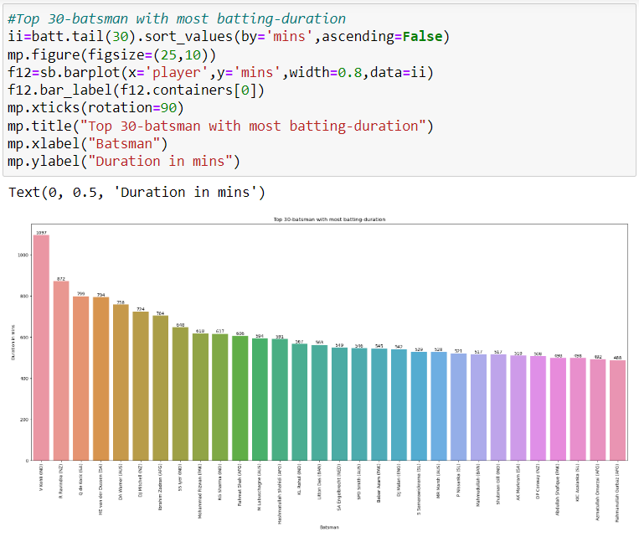
Player with most batting duration
Using the barplot, we observe that top 30 players with most batting duration throughout the tournament and Virat Kohli (IND) is the topper with 1027 mins.

Slide 40
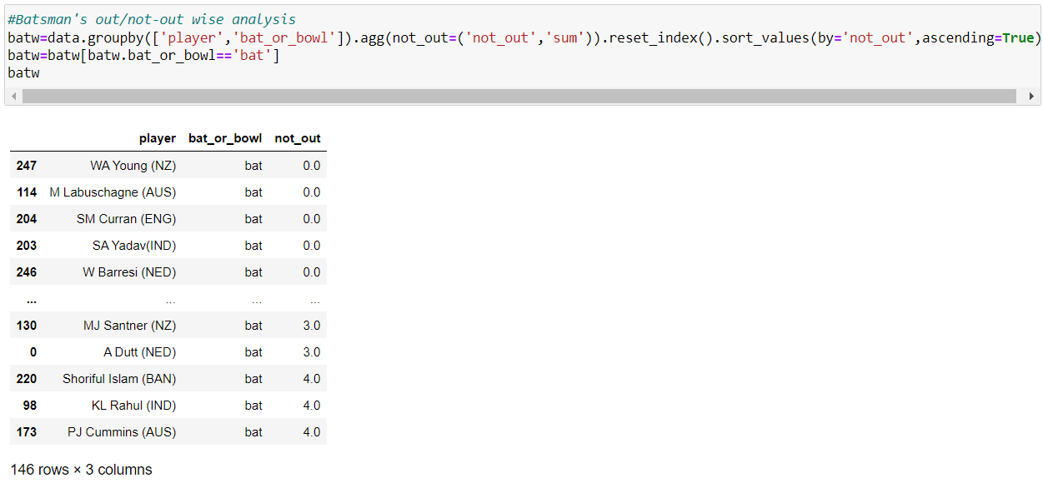
Batsman's batting not-out wise analysis
We're using groupby function to group out the batsmen with the sum of their not-outs in batting in ascending order.

Slide 41
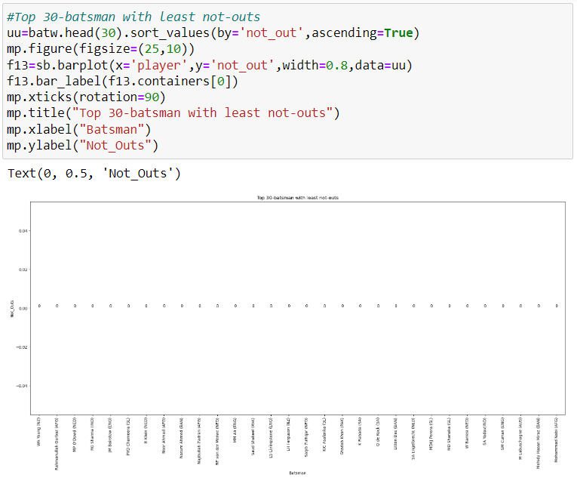
Player with least not-outs
Using the barplot, we observe that top 30 players with least not-outs throughout the tournament.

Slide 42
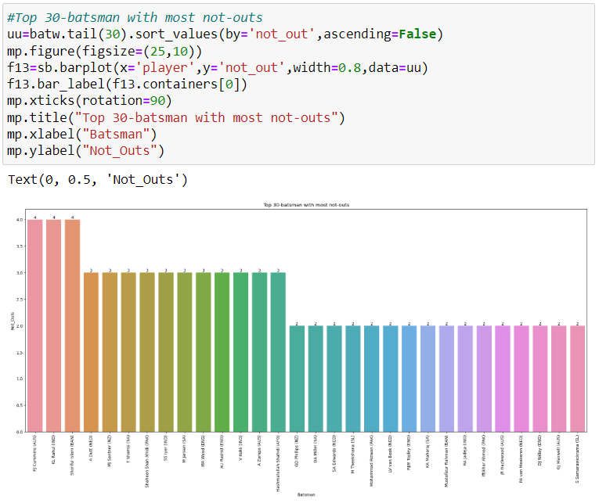
Player with most not-outs
Using the barplot, we observe that top 30 players with most not-outs throughout the tournament and three players are combined topper with 4 not-outs.

Slide 43
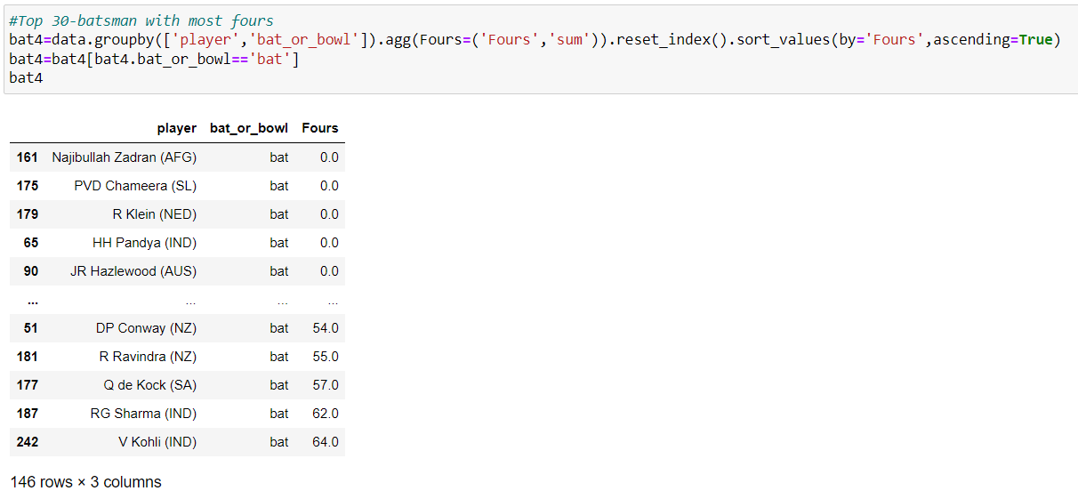
Batsman's with most 4s wise analysis
We're using groupby function to group out the batsmen with the sum of fours striked in ascending order.

Slide 44
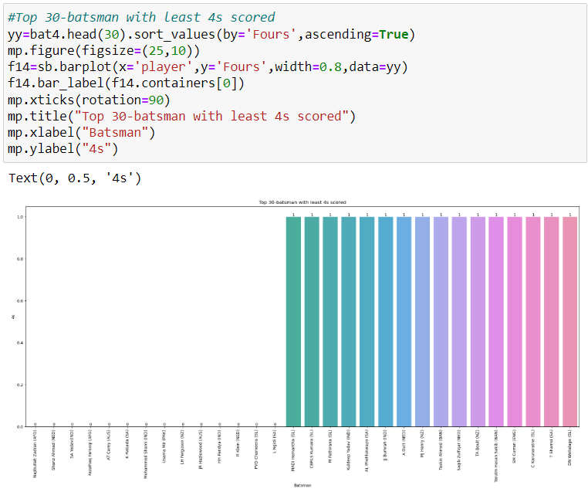
Player with least 4s
Using the barplot, we observe that top 30 players with least 4s throughout the tournament and there are 14 players with 0 4s.

Slide 45
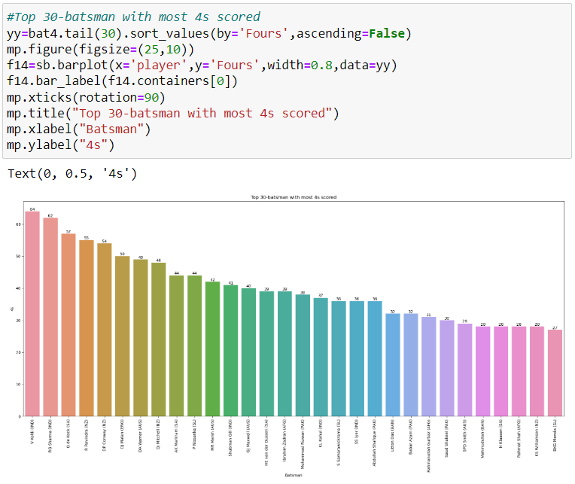
Player with most 4s
Using the barplot, we observe that top 30 players with most 4s throughout the tournament and V Kohli (IND) is the topper with 64 fours.

Slide 46
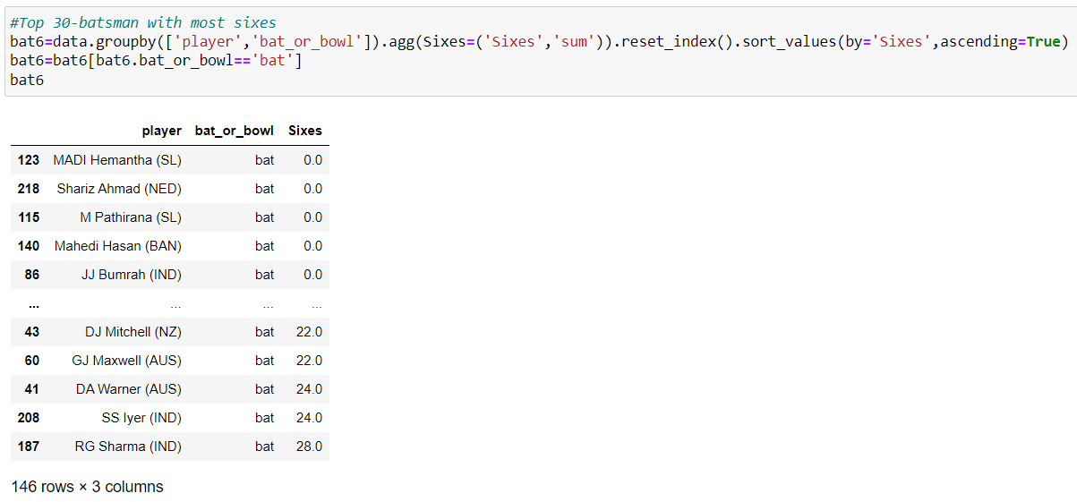
Batsman's with most 6s wise analysis
We're using groupby function to group out the batsmen with the sum of sixes striked in ascending order.

Slide 47
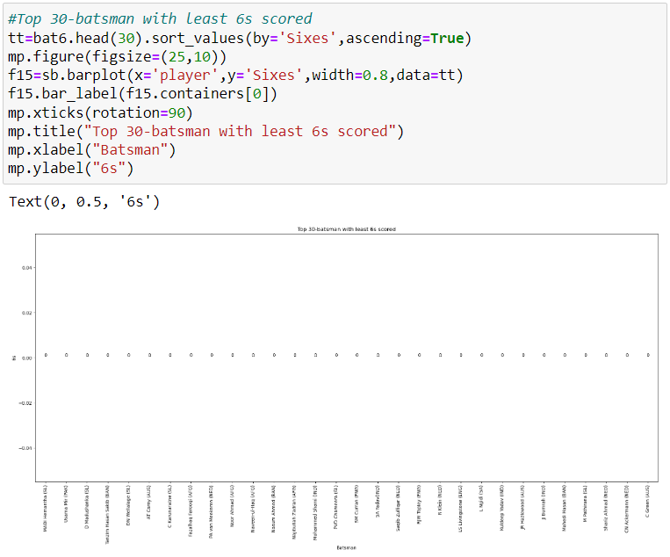
Player with least 6s
Using the barplot, we observe that top 30 players with least 6s throughout the tournament.

Slide 48
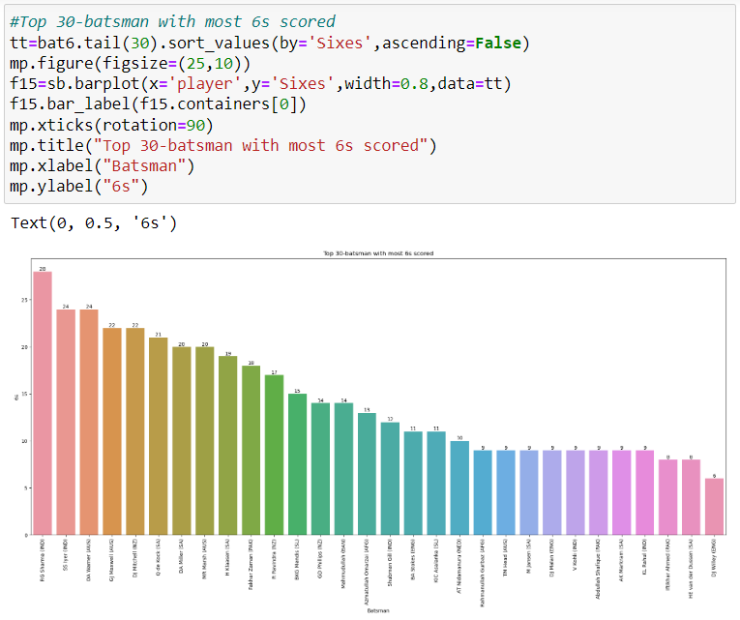
Player with most 6s
Using the barplot, we observe that top 30 players with most 6s throughout the tournament and RG Sharma (IND) is the topper with 28 sixes.

Slide 49
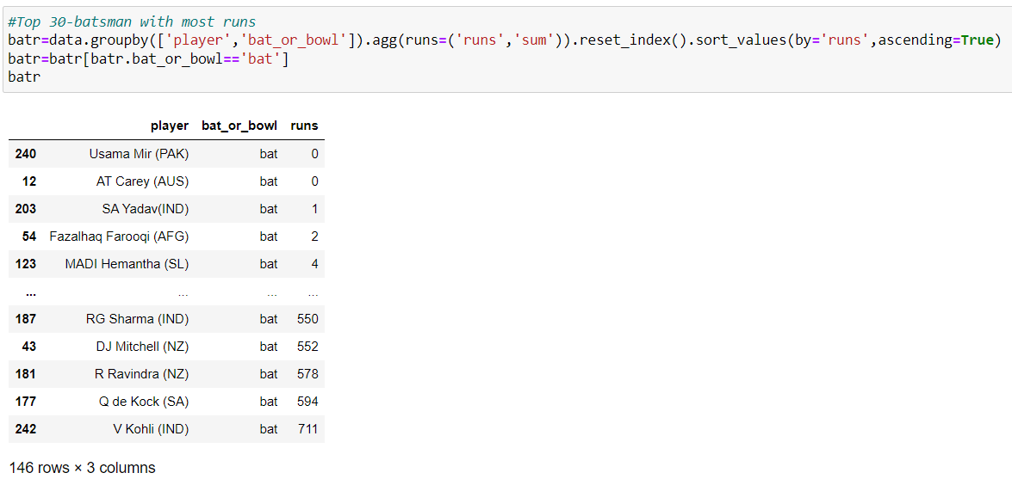
Batsman's with most runs-scored wise analysis
We're using groupby function to group out the batsmen with the sum of runs-scored in ascending order.

Slide 50
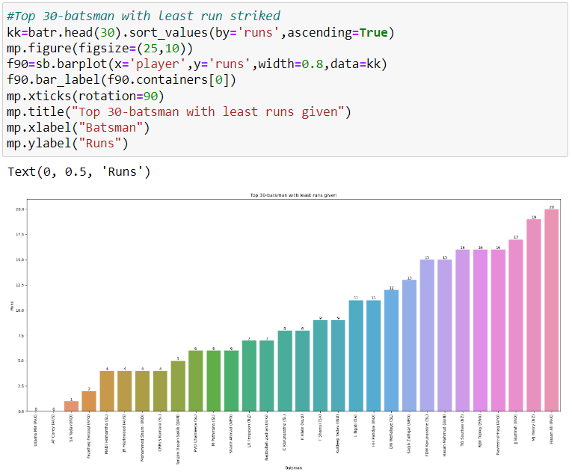
Player with least runs-scored
Using the barplot, we observe that top 30 players with least runs-scored throughout the tournament and there are two players with 0 run.

Slide 51
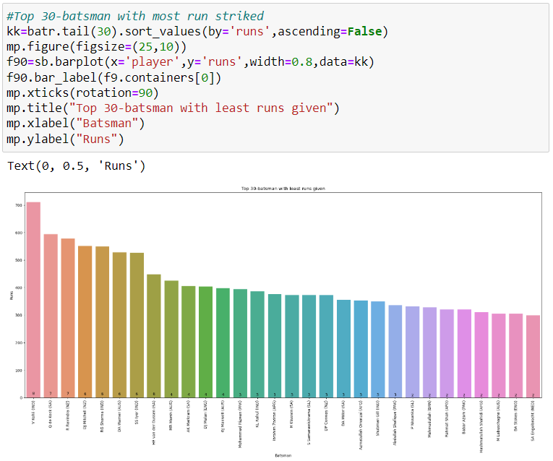
Player with most runs-scored
Using the barplot, we observe that top 30 players with most runs-scored throughout the tournament and V Kohli (IND) is the topper with 711 runs.

Slide 52
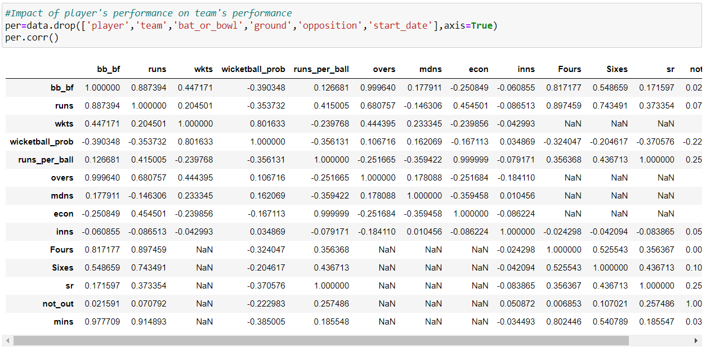
Impact of players on their team's performance
First we need to drop few attributes which don't contribute towards the performance.
Then using correlation we'll find the impact.

Slide 53
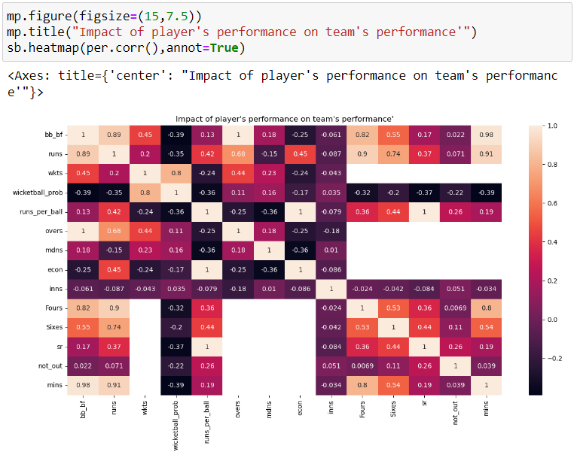
Impact of players on their team's performance
Using heatmap, we'll get the clear picture of the player's impact on the team's performance.

Slide 54
Opposition and ground analysis
This is our third task to perform, where we'll explore how teams perform against opposition, examine their performance variation amongst various grounds, and identify the strength of the team on certain conditions .

Slide 55
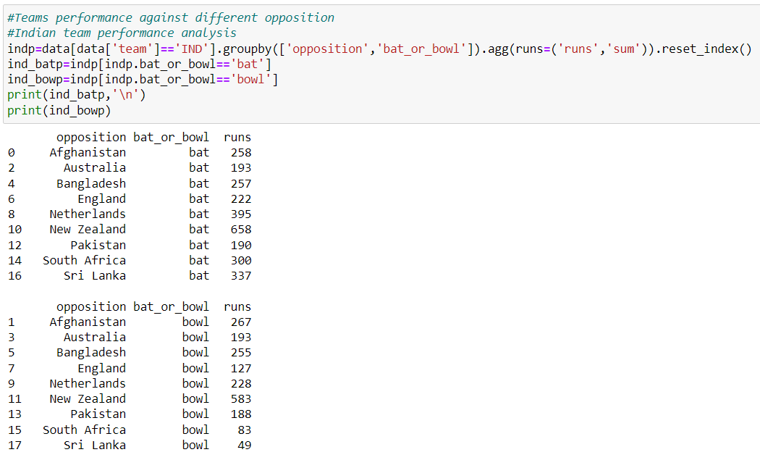
Indian team performance against opposition analysis
We're considering team India for performance analysis.
We find the runs-given and runs-scored by team India against different opposition.

Slide 56
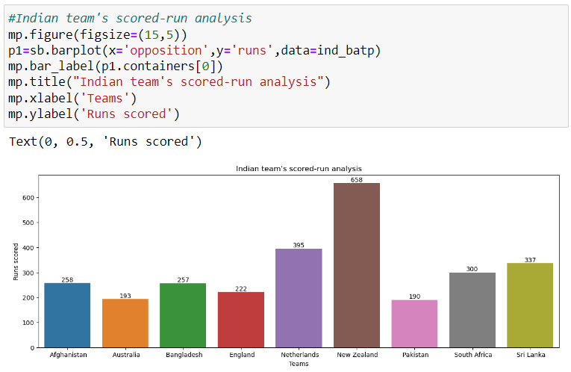
Indian team runs-scored analysis
Using the barplot, we observe that Indian team has scored maximum against NZ in two matches but in single match they've scored highest against Netherlands.

Slide 57
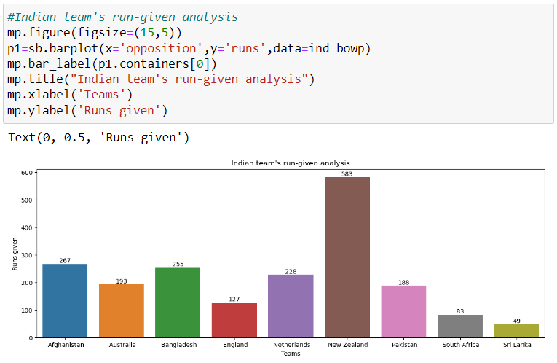
Indian team runs-given analysis
Using the barplot, we observe that Indian team has given maximum run against NZ in two matches but in single match they've given most against Afghanistan.

Slide 58
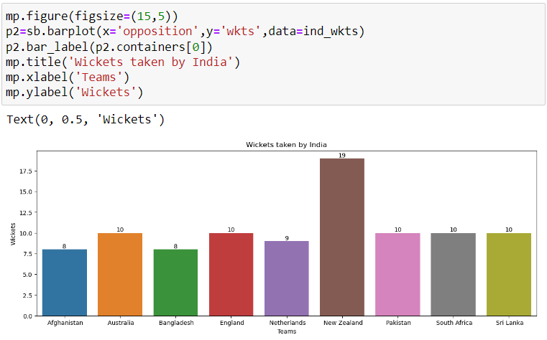
Indian team wicket taken analysis
Using the barplot, we observe that Indian team has maximum wicket against NZ in two matches but in single match they've taken 10 wickets against various team.

Slide 59
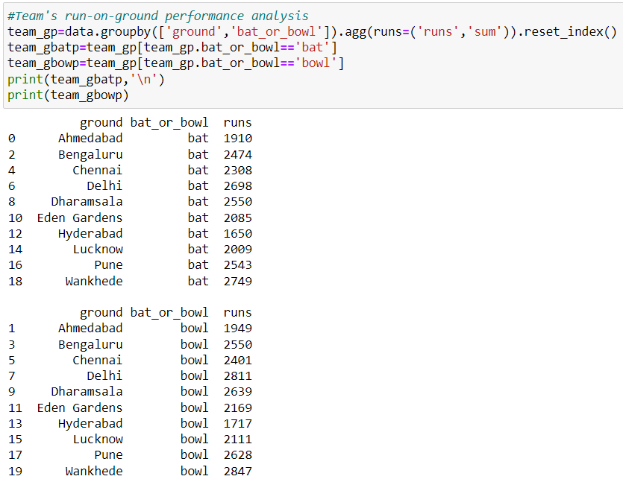
team performance in various ground analysis
Team wise run-on-ground analysis.
We find the runs-scored on different grounds.

Slide 60

team run-scored on-ground analysis
Using the barplot, we observe that team has scored maximum in Wankhede and minimum in Hyderabad.

Slide 61

team run-given on-ground analysis
Using the barplot, we observe that team has given maximum in Wankhede and minimum in Hyderabad.

Slide 62

team wicket on-ground analysis
Using the barplot, we observe that team has taken maximum wicket in Dharamsala and minimum in Hyderabad.

Slide 63

teams strength based on runs in grounds
Using the barplot, we observe that SA has scored maximum in Wankhede and for others simliarly.

Slide 64
Temporal analysis
This is our final task to perform, where we'll explore performance trend over time, considering start date and overs played and at last identify any temporal changes in team.

Slide 65

Parsing the dataset
We've to parse the 'start_date' attribute such that its type changes from object to datetime.

Slide 66

Cleaning the dataset
Using groupby function with 'start_date' and 'team' with the sum of overs.

Slide 67

Temporal analysis of all team
Using the lineplot, we observe that various teams like SA, AUS, IND has high temporal changes.

Slide 68

Temporal analysis of team on the basis of runs-scored
Using the lineplot, we observe that teams during final overs are scoring good amount of runs.

Slide 69

Temporal analysis of team on the basis of wickets
Using the lineplot, we observe that teams during final overs taking wickets linearly.

Slide 70

THANK YOU
Vaibhav Singh
Vaibhav.vaibhavsingh.singh80@gmail.com
MIP-ML-08

